Slide 1


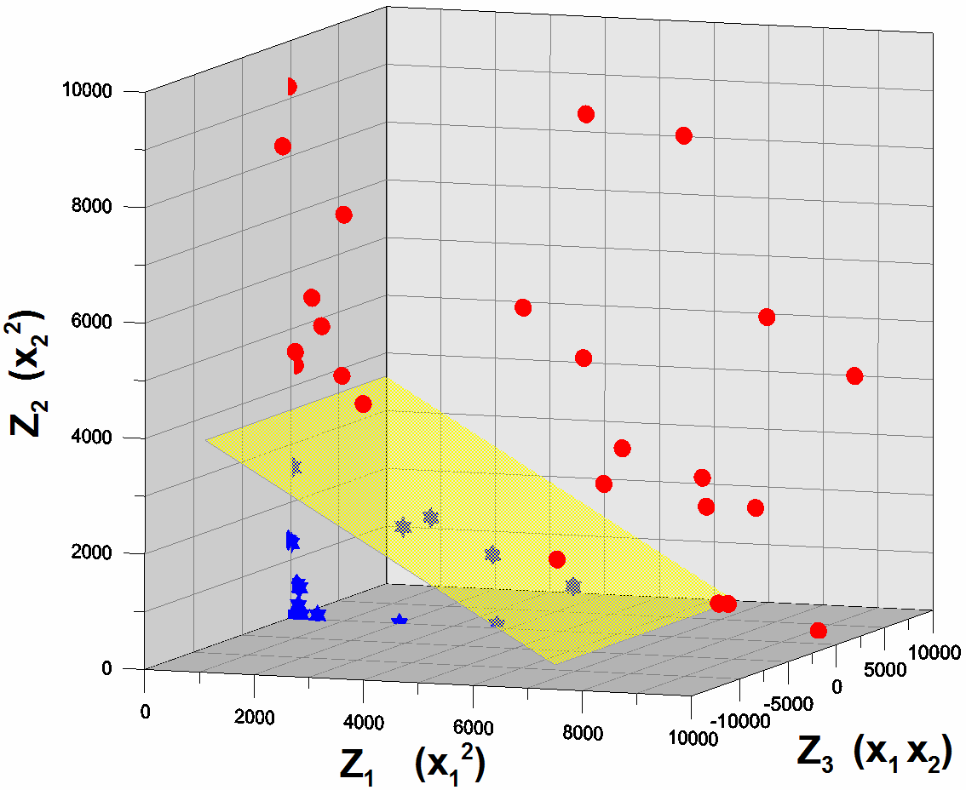
Customer Master File

Slide 2
Customer Master File:
Strategic Initiative
To enable the development and implementation of predictive insight analytics and establish “one version of the truth” through the construction of a Customer Master File…
This is not a new concept. It is one that the Customer Division has been working on for several years.

Slide 3
Customer Master File:
It’s Evolution
Stage 1 - 1998
  The first Marketing Decision Support System (MDSS) is developed; extracting key information from the Customer System and licensing tax parcel, and business firmographic data.
  The focus is Database Driven Marketing.
Stage 2 - 2000
  MDSS is expanded to integrate NE data after the acquisition of Eastern Enterprises. Residential Demographic information is licensed, and the company begins profiling and understanding its market place.
Stage 3 – 2008
  The Customer Experience Project begins; MDSS is recognized as critical to the project’s information needs.
  A strategic initiative to develop the Customer Analytic Record is undertaken.
  MDSS is upgraded to extract as much information as possible from all of National Grid’s Customer and other identified Systems.
  MDSS is renamed the Customer Insight and Analytics Platform – CIAP, as the company begins a focus on data mining and analytics in the Marketing space.

Slide 4
Customer Master File
It’s Evolution (Cont.)
Stage 4 – 2011
  Reorganization occurs, joining Customer Risk and Analytics with the Customer Division.
  Mandate is given to combine the data and information efforts of both organizations and create the Customer Master File, building upon CIAP as the platform.
  Acquisition of External & Internal data and information is significantly augmented in CIAP and is planned to continue to grow.
  The focus is now on supporting predictive analytics based upon modeling and simulation, in addition to Data Mining.
  The scope has also expanded to include Customer Strategy, Sales and Energy Procurement, all from a customer point of view:
    Energy Efficiency
    Customer Growth (new & conversions) and System Expansion
    Smart Grid and Non-Wires Alternatives.
    NGV/EV Fleet Vehicle Analysis.
    Distributed Generation
  Potential is seen for the Customer Master File to serve as the linkage and integration point of Customer, Engineering, and Operations Data.

Slide 5
Customer Master File:
Today and Where We Are Taking It
McGraw
Hill
IMS
Federal
No
Call
Moody’s
Address standardization
Distance to main
Geo-coding
Name Parsing
Other data hygiene
Data Fusion
OLAP Tools
Reed
Acxiom
Core
Logic
Polk
Weather
Data
Info
Group
DMA
NYISO
ISO-NE
External Data
Data Warehouse
(Maintains Source System Entities
with no joining of data across systems)
Customer
Master File
Internal Data
ETL
Operationalize
CRS
Regional
Mains
Data
Metretek
CAS
Siebel
CSS
Employee
SCADA
Advantage
Onyx
Two way direct connection
Analytic Tool Sets
Storms
Meter Data
Svcs
Engineering
Cost Data
Operations
Data
Primary
Research
Power
On
Outage Data
City Gate
Supply Data
Facilities
Data
SFDC
IAvenue
Operationalize in transactional systems
Planned Enhancement

Slide 6
Customer Master File:
The Role of Geo-Spatial Data
Common spatial data has been acquired across our footprint.
  Not available in Staten Island at this point in time.
The data consists of:
  The tax boundary coordinates of every tax parcel in our footprint.
  All Municipal boundaries for our footprint.
The parcel APN Number will be our common key for property identification purposes.
Through geo-coding against this dataset, every customer record will be appended with the APN number.
  A correct address will be tied to every parcel in our foot print.
Discussion was held and an opportunity to vet this data was provided to GIS Personnel from IT, GBU, and EBU.
  Feedback on this data was positive.
  This data will be made available to all GIS Resources in the company.

Slide 7
Customer Master File:
End State
A single, consistent database to support:
  The intelligent design of Customer business strategies, marketing & sales strategies and energy procurement strategies.
  A full Customer, Market, Business & Economic Simulation and Analysis enabling us to understand how our products, services, policies and strategies have impacted, do impact and will impact our Customers, our Markets, National Grid and the economies of the jurisdictions we operate in.
  The integration of Customer, Engineering, Asset Management, Operations and Shared Business Services data and information so as to enable the establishment of optimal business plans.

Slide 8
Appendix

Slide 9
Customer Master File:
Details of Internal Data Sources
Current Data Inventory
  Virtually a full copy of each of the Customer Systems.
    CRS, CAS, Onyx, Onyx Datamart.
  Customer Intelligence survey information
  Additionally, information from the following systems has been compiled in less of a complete system fashion.
    Siebel, InDemand, PowerOn, Advantage, IAvenue, Customer Call Center Trends Database.
In-Progress Data Inventory
  Any and all information connected to our customers or our ability to analyze our customers and market.
    Outage information for electric and gas
    Engineering data; both facility information and reinforcement/expansion cost information.
    Meter data from Metretek and Meter Data Systems
    SCADA Data
    Energy Efficiency data (InDemand and Vendor)
    Sales Force.Com
    Operations data; planned work locations and crew scheduling
    City Gate Supply Data

Slide 10
Customer Master File:
Details of External Data Sources
Current Data Inventory
  Residential demographics, purchasing histories, psychometrics and contact information from Acxiom and InfoGroup.
  Commercial Firmographics and contact information from InfoGroup.
  Spatial, Land-use, Structuregraphic and Tax Roll information from Core Logic.
  Regulatory contact mail and phone suppression files from the DMA/IMS and the FCC.
  Construction Starts and Permit information from Reed and McGraw Hill.
  Vehicle Fleet Registration information from Polk.
  Economic and Econometric information from Moody’s.
  Weather Data from the National Weather Service.
  Hourly load and price data from the NYISO and ISO-NE.

Slide 11
Customer Master File:
Details of Planned Data Sources
Any and all internal and external data and information directly or indirectly connected to our customers and/or our ability to analyze our customers and markets.

